Slide 1
LAB – 03
Classes, encapsulation, const & Outline functions

Slide 2

Task - 1
Create a class BankAccount with private members accountNumber, balance, and accountHolderName. Implement public methods to set and get the values of these private members using setters and getters.

Slide 3
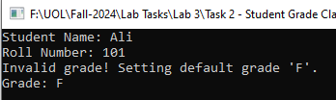

Task - 2
Define a class Student with private members name, rollNumber, and grade. Use public getter and setter functions to enforce encapsulation. Ensure that only valid data can be set for each member (e.g., grade must be between 'A' and 'F').

Slide 4
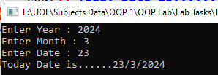
Task - 3
Write a C++ program that defines a class Date with private data members year, month, and day. The class should have a member function setDate() to input the date from the user and a function printDate() to display the date in the format day/month/year.

Slide 5
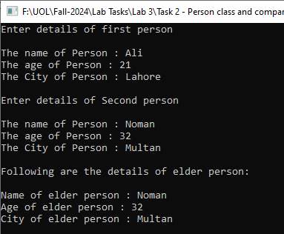
Task - 4
Write a C++ program that defines a class Person with private members name, city, and age. The class should have member functions input() to take user input, getAge() to return the person's age, and display() to show the details of the elder person. In the main() function, input details for two persons, compare their ages, and display the details of the elder person. If both are the same age, display an appropriate message.

Slide 6
Task - 5
Create a class Rectangle with private members length and width. Implement a constant member function getArea() to calculate and return the area. Ensure that the function does not modify any class members.
Area = Length * Width

Slide 7
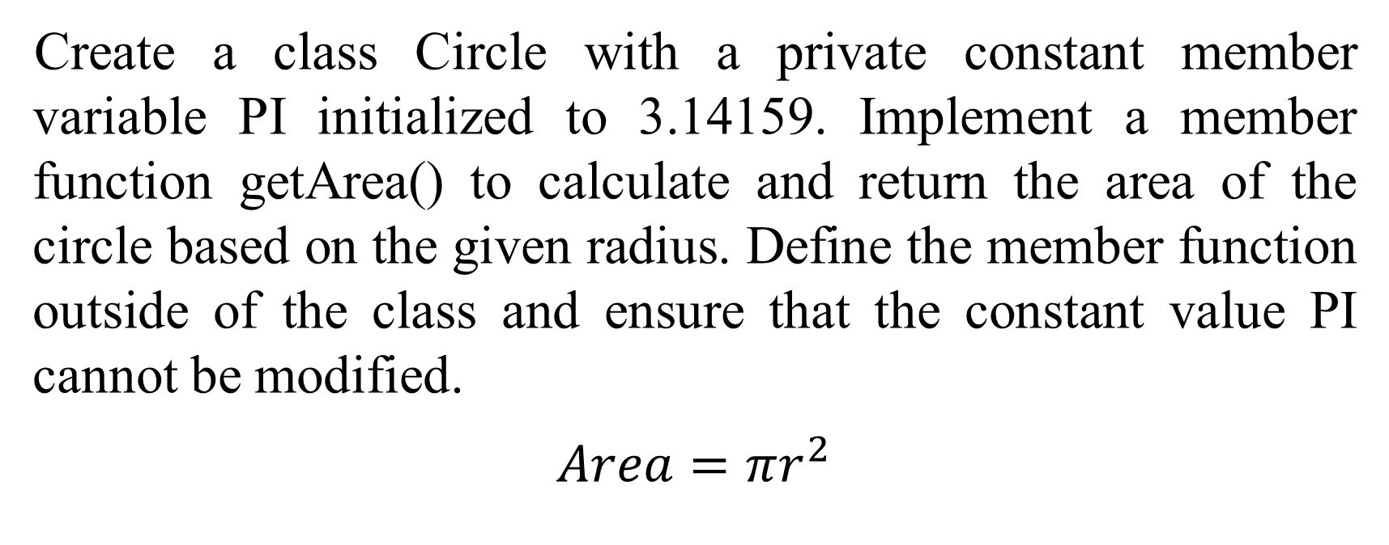
Task - 6
Create a class Circle with a private constant member variable PI initialized to 3.14159. Implement a member function getArea() to calculate and return the area of the circle based on the given radius. Define the member function outside of the class and ensure that the constant value PI cannot be modified.
$Area=πr^{2}$

Slide 8
Task - 7
Create a class Employee with private members name, id, and salary. Implement the member functions setData() and getData() outside of the class to set and display employee details.

